Slide 1
Address Book with DVD Loan
Group 2 Workshop Project
Conception
Main Menu TUI
Usecases
Sequence Diagrams
System Sequence Diagram
Coding
Conclusion

Slide 2
Address Book with DVD Loan
Group 2 Workshop Project
Conception
Usecases
Sequence Diagrams
System Sequence Diagram
Coding
Conclusion

Slide 3
Goal Of The Program
An address book designed to be able to hold information about our friends and a list of DVD's that we are willing to lend out
The system should be designed in a 3 layer Arcitect

Slide 4
Requirements of the system
The address book should be able to hold an ID number
The address book should be able to hold, Name,Address, and Phone Number
You should be able to register DVD's
You should have the ability to modify information and get information about your friends and the DVD's
You should have the ability to lend out DVD's
You should be able to see what person has borrowed which DVD

Slide 5
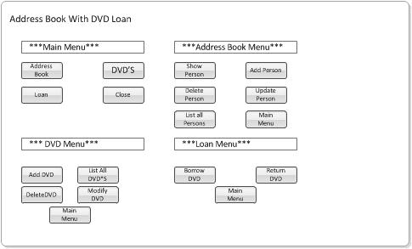
Main Menu TUI

Slide 6
Fully Dressed Use Case

Slide 7
Strengths and Advantages
Summarize the special features and advantages of the product being introduced

